Slide 1



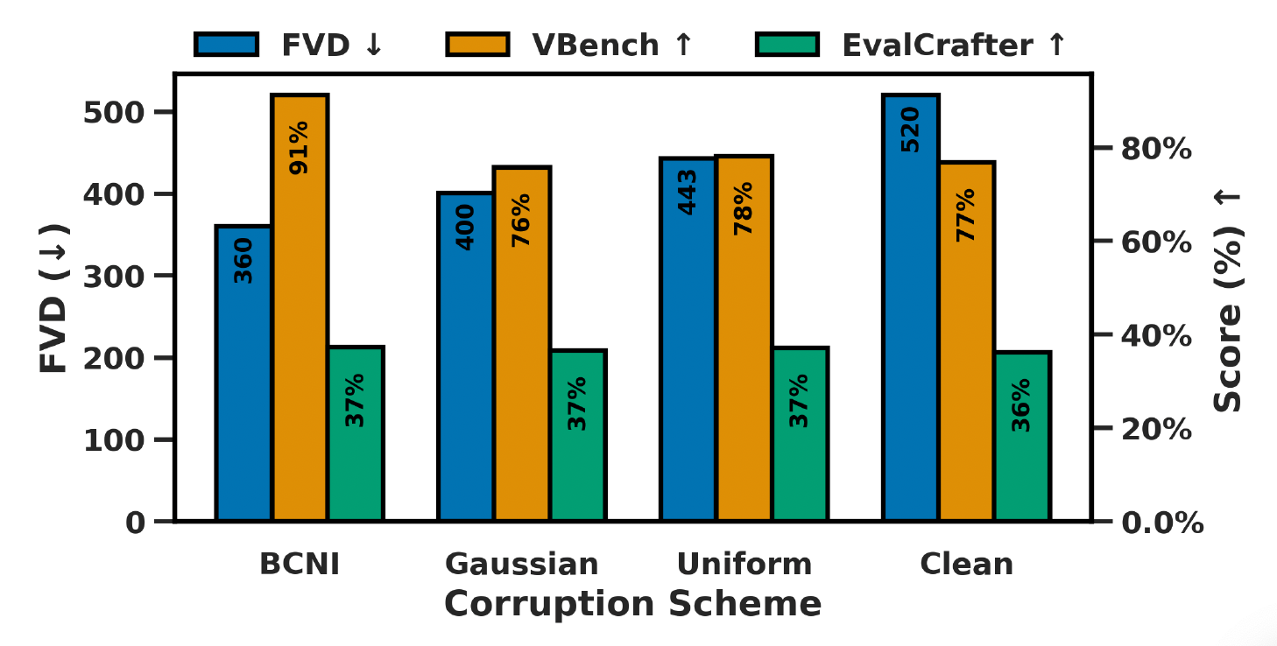
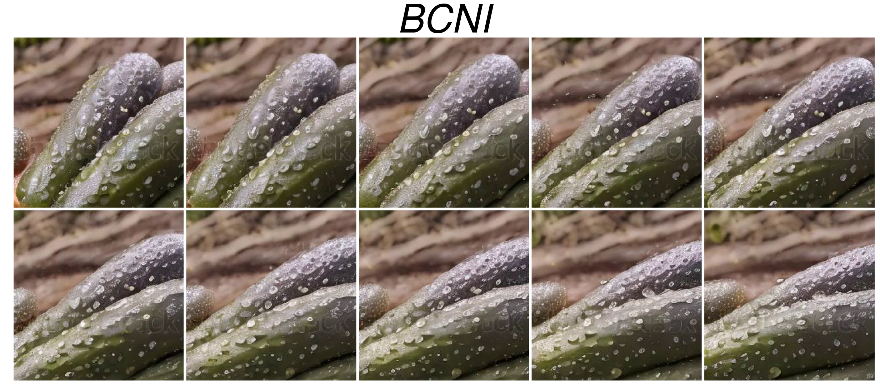
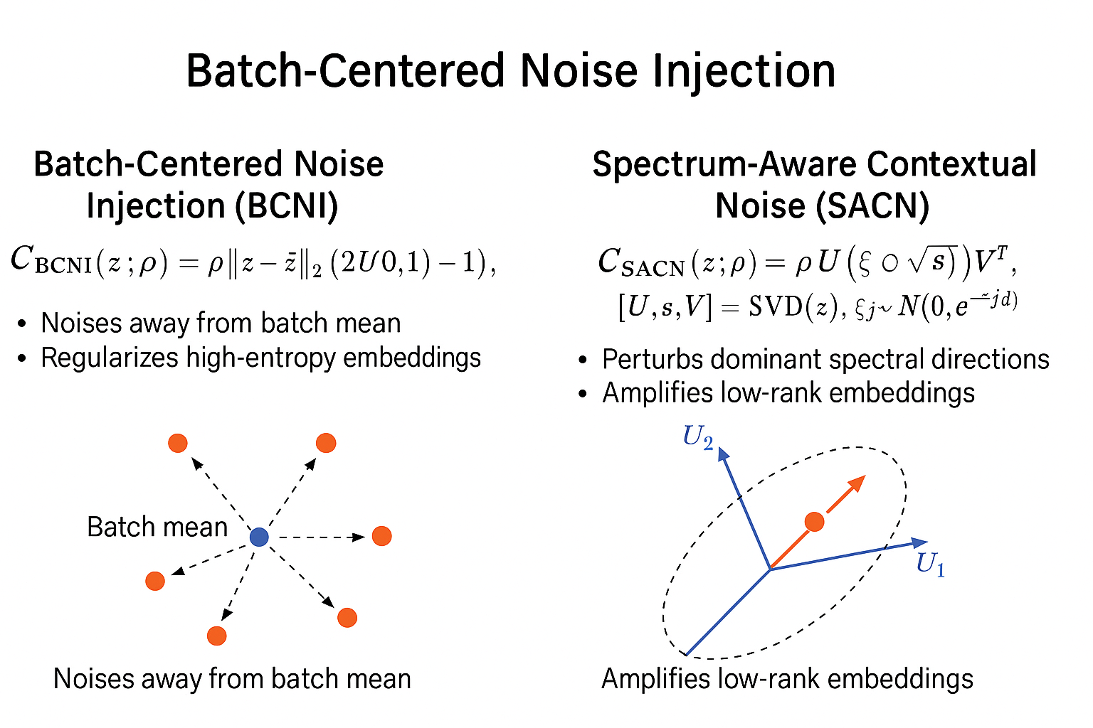
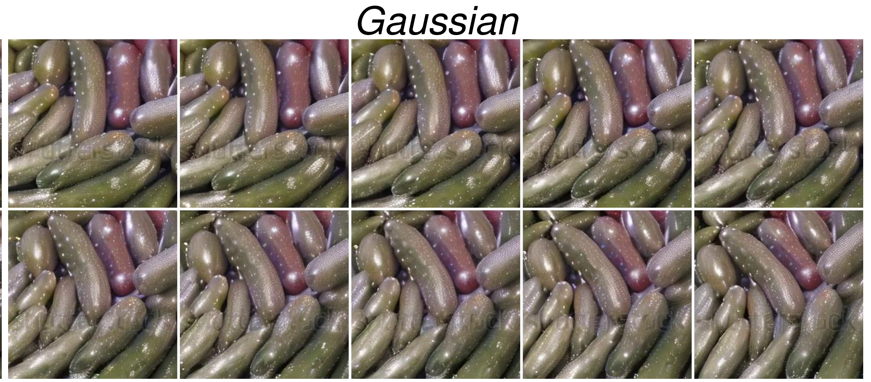
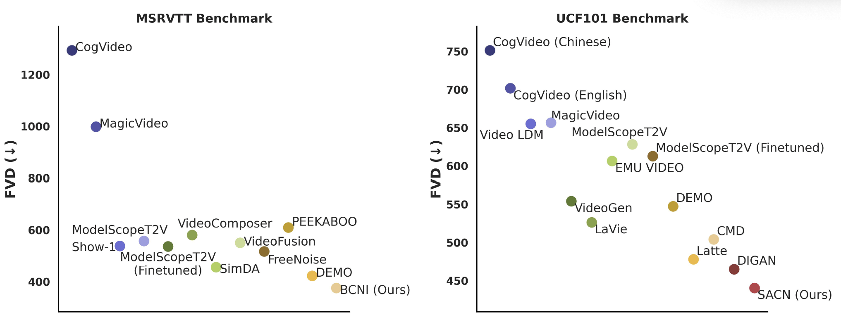
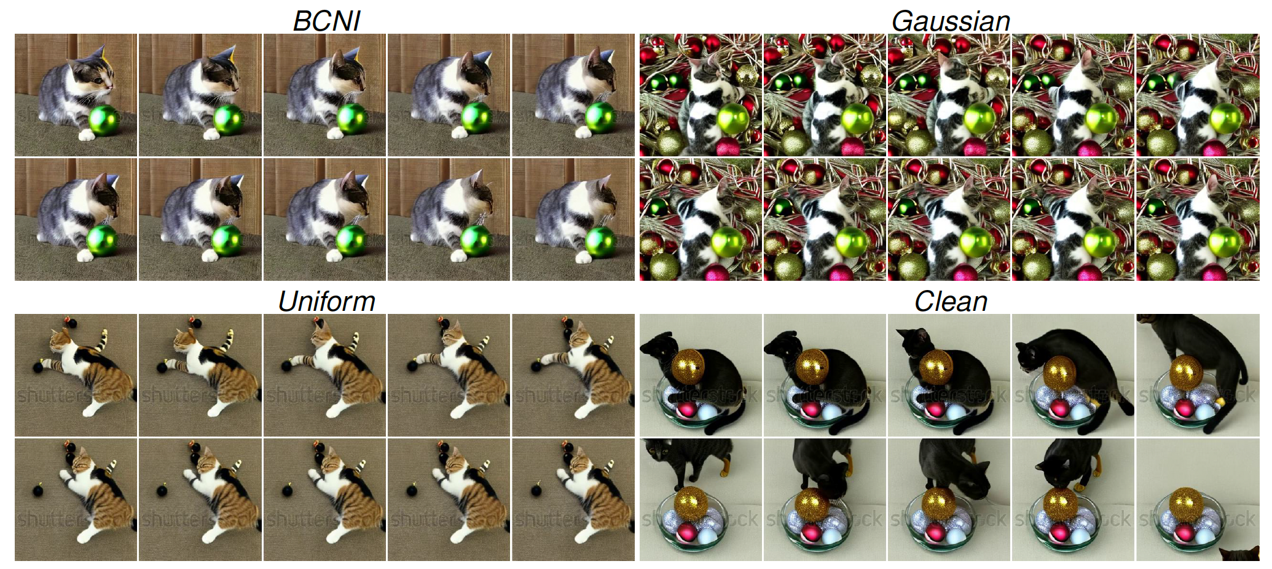
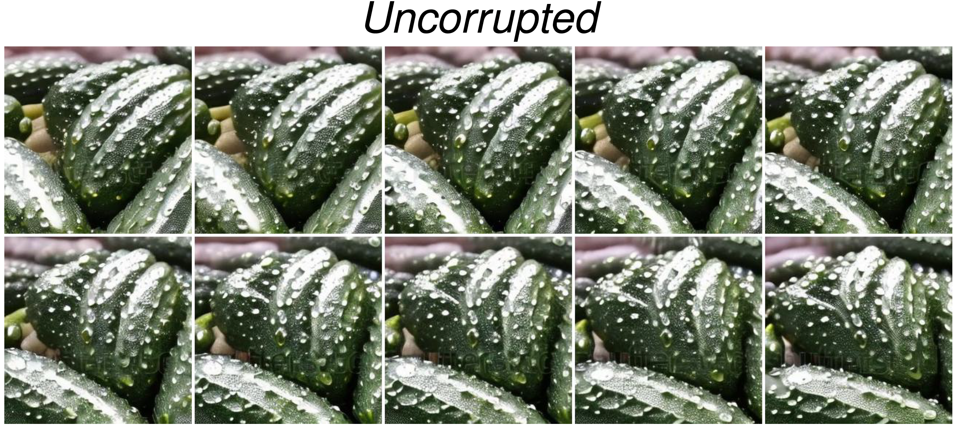
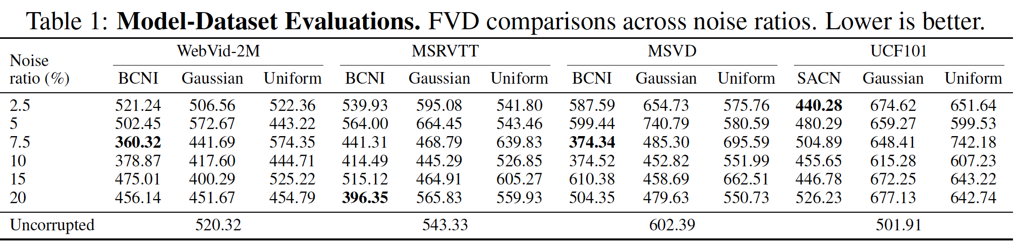
Robust Video Diffusion via Structured Corruption
Chika Maduabuchi, Hao Chen, Yujin Han, Jindong Wang
The Fragility of Latent Video Diffusion
Quantitative Results
BCNI & SACN beat all benchmarks
Qualitative Results
Problem:
Latent video diffusion assumes perfectly clean text prompts or embeddings, yet actual captions are noisy.
Effect:
Structured corruption improves robustness, outperforming clean training across all metrics.
Fix:
Train with structured batch-centered noise (BCNI) to map noisy inputs to clean manifolds on WebVid, MSRVTT, and MSVD. For short prompts, use spectrum-aware contextual noise (SACN) on the UCF-101 dataset.
Prompt: Rotation, close-up, falling drops of water on ripe cucumbers.
Observation: BCNI preserves fine water and cucumber detail and motion coherence better than Gaussian or Uncorrupted baselines.
Codes and pre-trained models are at
https://github.com/chikap421/catlvdm

